Slide 1
Presentation On
VIRTUAL ASSISTANT
IN PYTHON
Presented By :
Name Roll no.
Mr. Meghraj Fand 313
Mr. Vaibhav Kale 336
Mr. Saurabh Pawar 356
Mr. Vijay Shete 368
Guided By
Prof S. N. Nimbalkar
Department of Computer Engineering

Slide 2
Introduction :
The rise of automation, along with increased computational power, novel application of statistical algorithms, and improved accessibility to data, have resulted in the birth of the personal digital assistant market, popularly represented by Apple’s Siri, Microsoft’s Cortana, Google’s Google Assistant, and Amazon’s Alexa.
While each assistant may specialize in slightly different tasks, they all seek to make the user’s life easier through verbal interactions so you don’t have to search out a keyboard to find answers to questions like “What’s the weather today?” or “Where is Switzerland?”. Despite the inherent “cool” factor that comes with using a digital assistant, you may find that the aforementioned digital assistants don’t cater to your specific needs. Fortunately, it’s relatively easy to build our own.

Slide 3
Objective :
In this project we have build our own digital virtual assistant in Python, complete with voice activation plus response to a few basic inquiries. From here, we can customize it to perform whatever tasks we need most.

Slide 4
Steps to build virtual assistant :
Step 1 : Install Python
Step 2 : Import third party packages required for the project –
Speech Recognition Package – when you voice a question,
we’ll need something that can capture it. The SpeechRecognition
package allows Python to access audio from your machine’s
microphone, transcribe audio, save audio to an audio file, and
other similar tasks.
Text to Speech Package – our assistant will need to convert your
voiced question to a text one. And then, once the assistant looks
up an answer online, it will need to convert the response into a
voiceable phrase. For this purpose, we’ll use the pyttsx3 package.
Audio Playback Package – All that’s left is to give voice to the
answer. The mpyg321 package allows for Python to play
MP3 files.

Slide 5
Step 3 : Voice input –
The first step in creating our own personal digital assistant is
establishing voice communication. We’ve created two functions
using the libraries we just installed: one for listening and
another for responding along with a few of the standard Python
libraries
1. def listen()
This uses the SpeechRecognition library to activate your
machine’s microphone, and then converts the audio to
text in the form of a string
2. def respond()
This uses the gTTS library take a string input, prints it,
then convert the string to an audio file. This audio file
is saved to the local directory and then played by our
operating system.

Slide 6
The listen and respond functions establish the
most important aspects of a digital virtual
assistant: the verbal interaction. Now that
we’ve got the basic building blocks in place,
we can build our digital assistant and add in
some basic features.

Slide 7
Step 3 : Voiced Response
To construct our digital assistant, we’ll define
another function called digital assistant and provide it with a couple of basic responses:
1 . How are you?
-> I’m fine.
2. What is time?
-> respond(time)
3. stop listening.
-> Listening stopped

Slide 8
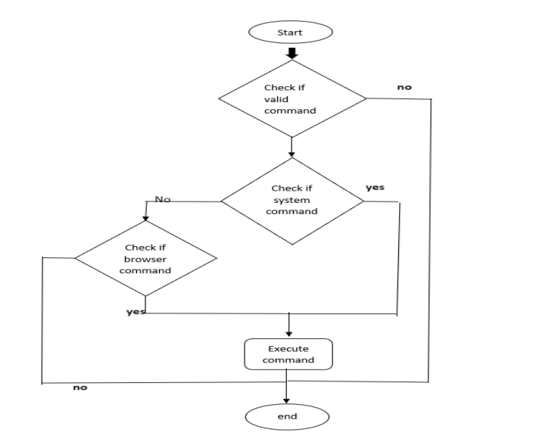
System Flowchart :

Slide 9
Different query we have created :
Digital Assistant Google Maps Query
Digital Assistant Weather Query

Slide 10
Conclusion:
Through this voice assistant, we have automated various services using a single
line command. It eases most of the tasks of the user like searching the web,
retrieving weather forecast details, vocabulary help and medical related queries.
We aim to make this project a complete server assistant and make it smart
enough to act as a replacement for a general server administration.

Slide 11
References :
[1] Yash Mittal, Pradhi Toshniwal “A voice-controlled multifunctional
Smart Home Automation System”, 2015 India Conference (INDICON),
IEEE.
[2] Prerna Wadikar, Nidhi Sargar, Rahool Rangnekar, Prof.Pankaj
Kunekar “Home Automation using Voice Commands in the Hindi
Language”, 2020, IRJET.
[3] Nagesh Singh Chauhan,“Build Your First Voice Assistant”,March,2019
https://towardsdatascience.com/build-your-first-voiceassistant.
[4] Manohar Swamynathan, “Mastering Machine Learning with Python”,
Karnataka: Apress, 2017.
[5] Yu Zhong, T. V. Raman, Casey Burkhardt, FadiBiadsy and
Jerey P. Bigham, "JustSpeak: Enabling Universal Voice
Control on Android", April 2014.

Slide 12
Thank You

